Slide 1
Gradient Descent for Deep learning
KAIM `17
Anand Krish

Slide 2
Agenda
Deep Learning & Optimization
The Old that is New
What is being Optimized?
Gradient Descent Algorithms
Why Gradient Descent?
Overview of Stochastic Variants
Discussion

Slide 3
Episode 1 Deep Learning & Optimization

Slide 4
Introduction to Deep Learning
Automatic feature extraction and selection
Hierarchical data representation – based on levels of abstraction
Perform broad categories of tasks over generic datasets
“Kinda-sorta” biologically inspired
Automatic learning
Multi-dimensional
Proof of learning by generation
Learn, Unlearn and Relearn

Slide 5
The Old that is New
Deep Learning is a modern (fancy) name for the idea that has existed since 1980s
Convolutional Neural Networks was proposed in 1998 [LeCun et. al]
LSTMs [example of a Recurrent Neural Network] in 1997
Successfully resurrected due to –
Availability of large amounts of data
Higher Computing Power (GPUs, TPUs etc)
Bigger Models
Better Learning Algorithms - Backprop
Bigger Data
Better Computing Power
Better Results
Further Improvements

Slide 6
Optimise!!! … But What?
The error between our model prediction and the target of course!
Beginners’ Wisdom: Deep Learning = Optimization
But do what we want? – Reduction in the generalization Error
What do we do? – Reduce the Training Error
Training Error and Generalization error are NOT the same
Has dire consequences (meh! We will still do it)
Ergo, Deep Learning ≠ Optimization
Consensual Reality : Optimize anything that reduces the generalization error
Finding it is tough!

Slide 7
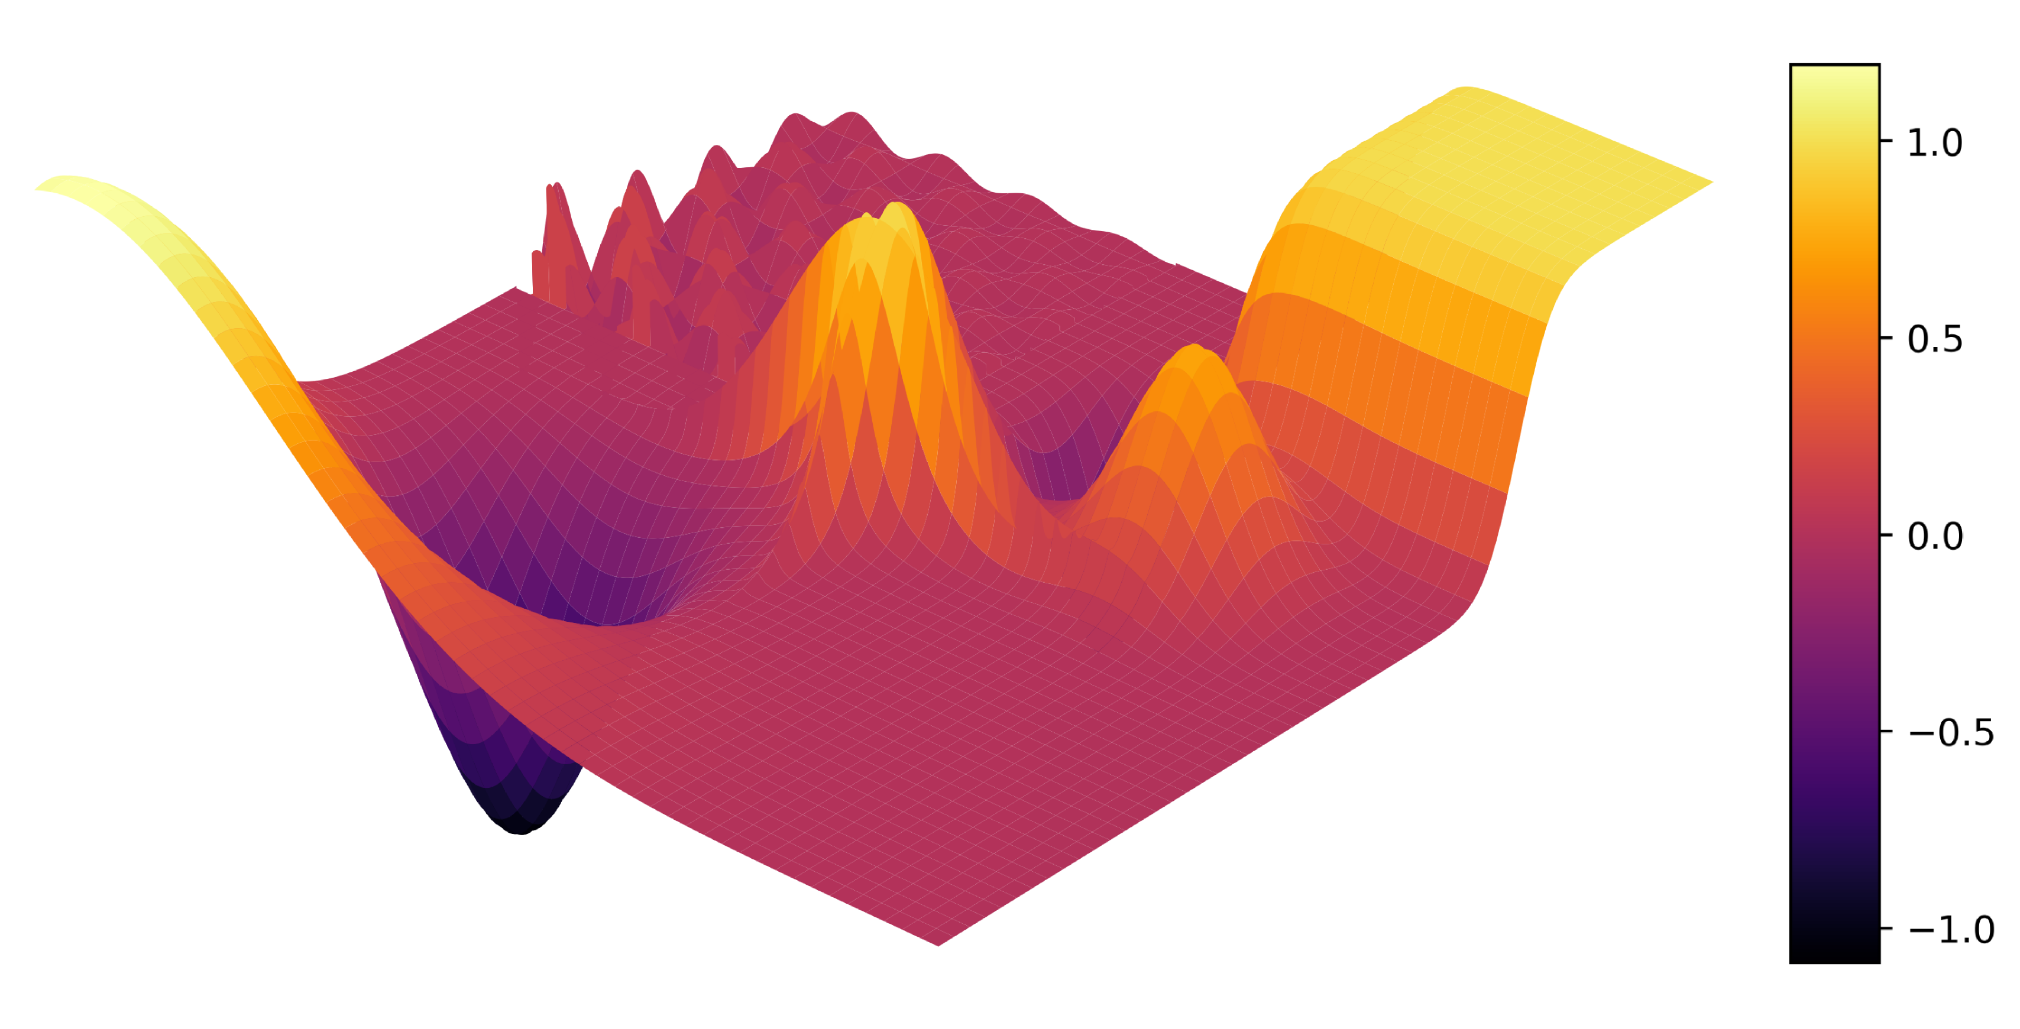
Optimization Landscape
Local Extrema, Saddle Points, Cliffs, Plateaus, Narrow gorges and sharp peaks

Slide 8
Episode 2 Gradient Descent

Slide 9
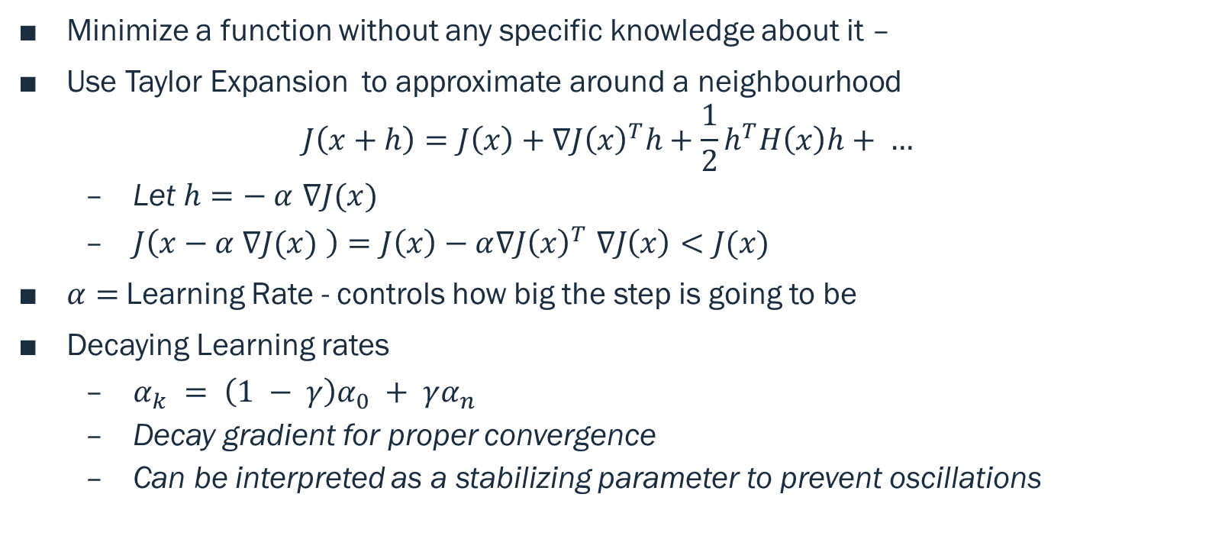
The Gradient Descent
Minimize a function without any specific knowledge about it –
Use Taylor Expansion to approximate around a neighbourhood
$$J\left(x+h\right)=J\left(x\right)+∇J{\left(x\right)}^{T}h+\frac{1}{2}h^{T}H\left(x\right)h+ …$$
Let $h=− α$ $∇J(x)$
$J\left(x−α ∇J(x) \right)=J\left(x\right)−α∇J{\left(x\right)}^{T} ∇J\left(x\right)<J(x)$
$α=$Learning Rate - controls how big the step is going to be
Decaying Learning rates
$α_{k} = \left(1 − γ\right)α_{0} + γα_{n}$
Decay gradient for proper convergence
Can be interpreted as a stabilizing parameter to prevent oscillations

Slide 10
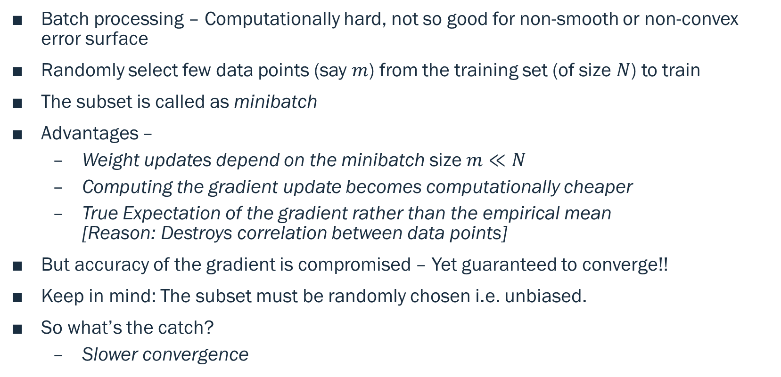
Idea – Minibatch
Batch processing – Computationally hard, not so good for non-smooth or non-convex error surface
Randomly select few data points (say $m$) from the training set (of size $N$) to train
The subset is called as minibatch
Advantages –
Weight updates depend on the minibatch size $m≪N$
Computing the gradient update becomes computationally cheaper
True Expectation of the gradient rather than the empirical mean [Reason: Destroys correlation between data points]
But accuracy of the gradient is compromised – Yet guaranteed to converge!!
Keep in mind: The subset must be randomly chosen i.e. unbiased.
So what’s the catch?
Slower convergence

Slide 11
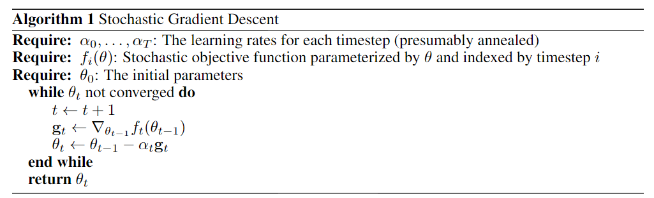
Stochastic Gradient Descent

Slide 12
Idea – Momentum
A ball falling along a slope gathers momentum (due to gravity) → Falls faster
Incorporate Momentum in our gradient descent algorithm (But without gravity of course!)
Simple – Gradient direction is weighted based on previous directions
Problem – Overshoot Solution – Average the past gradients
Advantages –
Much faster convergence
Omits narrow gorges and performs well along cliffs
Avoids sudden changes in gradient directions
Insight – Basically acts as a correcting mechanism

Slide 13
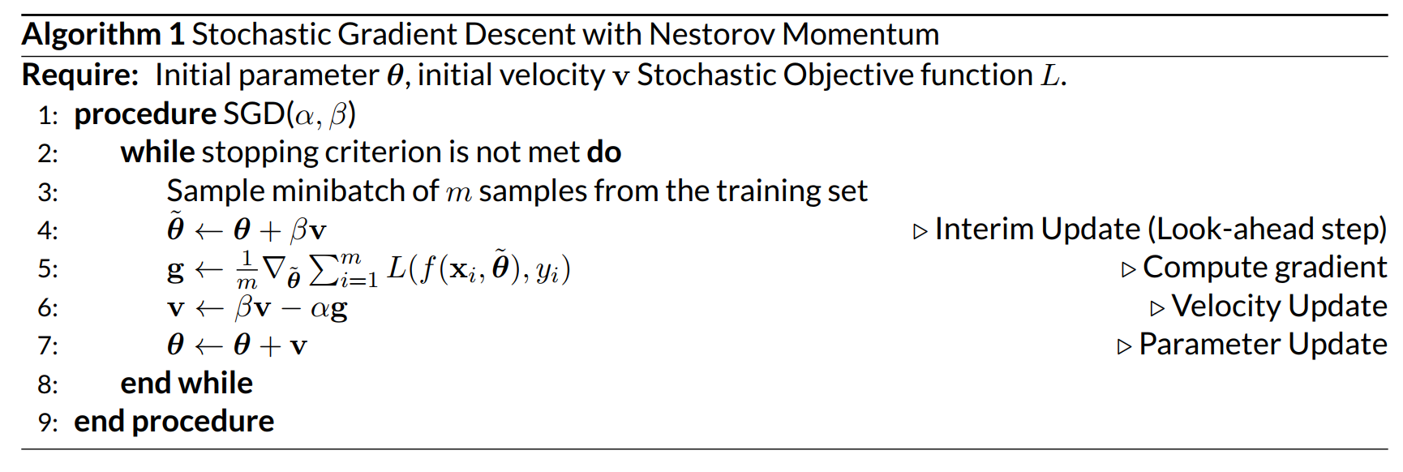
SGD with Momentum

Slide 14
Hmm… How can we improve it further?
What if the algorithm can automatically adapt the learning rates irrespective of the terrain?
Convex or Non-convex terrains, shallow valleys etc
Adaptive learning rate for each of the parameters to be optimised
Account for initialization bias i.e. irrespective of where we start, the algorithm must perform optimally (Extremely Important)
Less sensitive to sudden asymmetric changes in the landscape i.e in some gradient directions but not the other

Slide 15
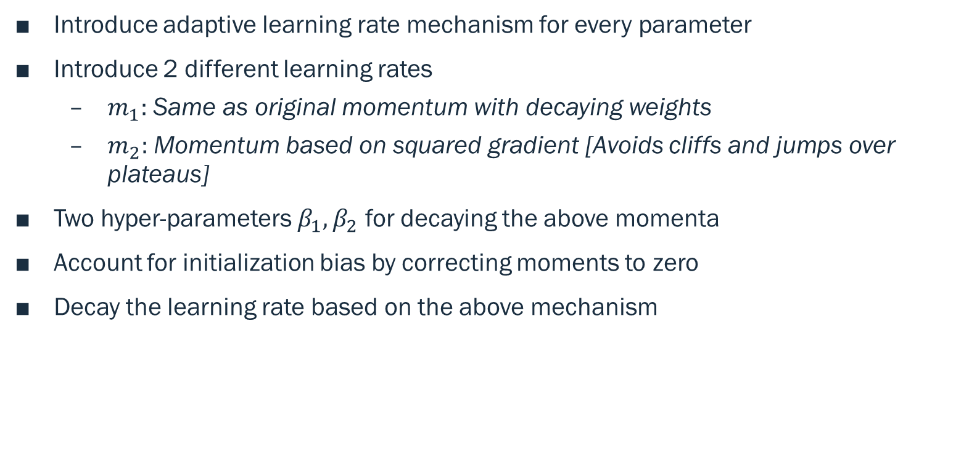
Idea – Adaptive Learning Rates
Introduce adaptive learning rate mechanism for every parameter
Introduce 2 different learning rates
$m_{1}:$ Same as original momentum with decaying weights
$m_{2}:$ Momentum based on squared gradient [Avoids cliffs and jumps over plateaus]
Two hyper-parameters $β_{1},β_{2}$ for decaying the above momenta
Account for initialization bias by correcting moments to zero
Decay the learning rate based on the above mechanism

Slide 16
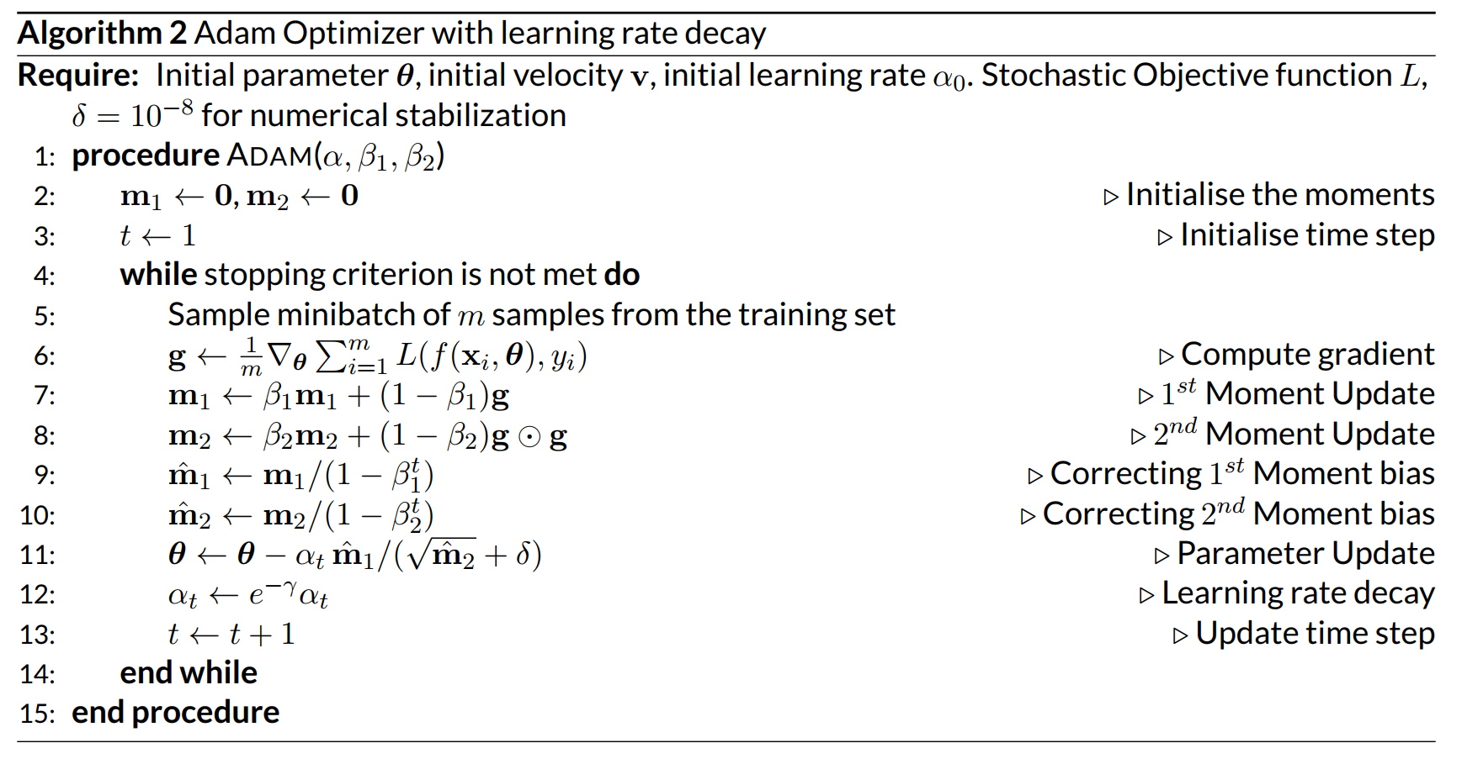
ADAM Optimizer

Slide 17
Discussion Time

